Slide 1
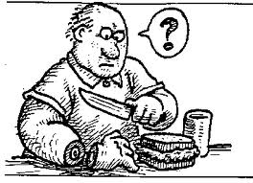
AP Unit 11 Testing and Individual Differences pt. 1
cantrip.org
cantrip.org
What makes us smart?
Or not so smart?

Slide 2
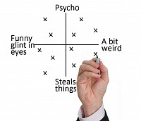
Table of Contents:
Standardization and Norms
Reliability and validity
Types of Tests
Ethics and standards in testing
Intelligence
Intelligence testing
Kinds of intelligence
Heredity/environment and intelligence
Human diversity

Slide 3
Standardization and Norms
Psychometrics: measurement of mental traits, abilities, and processes.
Psychometricians are involved in test development in order to measure some construct or behavior that distinguishes people.
Constructs are ideas that help summarize a group of related objects.
For example, we can’t measure happiness, honesty or intelligence in feet or meters. Even though we cannot observe happiness they are a useful concept for understating, describing, predicting and influencing behavior.
http://www.youtube.com/watch?v=mZTcniw5NKc

Slide 4
How do we construct an Intelligence Test?

Slide 5
Standardization and Norms
Standardization: is a two part test development procedure that first establishes test norms from the test results of the large sample.
Norms are scores established from the test. For example the means core for the SAT is 500.
When administering a standardized test, all proctors must give same directions and conditions and scores sheets.

Slide 6
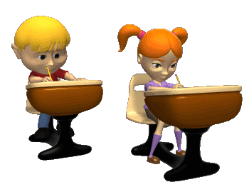
How do we construct an Intelligence Test?
Standardized: the questions have been piloted on similar populations and the scores fall on a normal distribution.
Reliable: Test-Retest, Split-halves Methods.
Validity: Content, Predictive or Construct.

Slide 7
Reliability and validity
Reliability refers to when you can obtain the same score no matter where, when or home many times we take it.
***The closer the correlation coefficient is to 1.0 the more reliable the test.
Test-Retest Reliablity: Give test to a large group, then give exactly the same test to same group later and you should get the same results.
Split-Half: The test is split into two equal parts (odd-even) and scores are compared.

Slide 8
Reliability and validity
Valid: it is accurate, the test accurately measures or predicts what it is suppose to.
Face Validity: Looks like it tests what it’s supposed to or claims to test
Content Validity: measure extent of the knowledge
Criterion related validity: The test is measured against an overall goal or proficiency (meeting the criteria). (Alabama High School Graduation Exam)
Predictive Validity: forecasts a specific future result. For example. The SAT is designed to predict how well someone will succeed in their freshman year in college.
Construct Validity: measures behavior. For example the MMPI.

Slide 9
Types of Tests
Psychological tests can be sorted into 3 categories of:
1. Performance Tests,
2. Observational Tests,
3. Self-report Tests

Slide 10
Types of Tests
Performance Tests: SAT’s , AP, Wechsler intelligence test, Stanford-Binet intelligence, classroom tests, finals, driver’s license
Observational Tests: person being tested does not have a single well defined task but assessed on typical behavior.: Employment interviews, on the job observations.
Self-Report Tests require the test taker to describe his or her feelings, attitudes, beliefs, values, opinions, physical state: MMPI

Slide 11
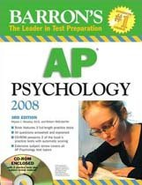
Another Type of Tests can be categorized into ability, interest, and personality tests relevant to decision making:
Aptitude:
Measure ability or potential.
Achievement:
Tests that measure what you have learned.

Slide 12
Ethics and Standards in Testing
Because some groups (such as African Americans) have tended to score lower on average than other groups (such as European Americans) on intelligence tests and SATS, critics argue that tests are bias. Not biases with respect to predictive validity but biased with respect to performance differences from cultural experience.
Culture relevant tests incorporate skills and knowledge related to the cultural experiences of the test takers. Ex. Questions about boll weevil

Slide 13
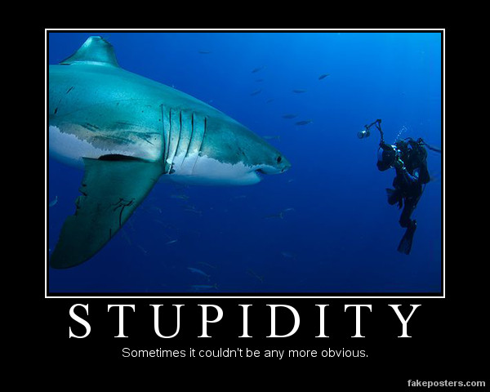

Slide 14
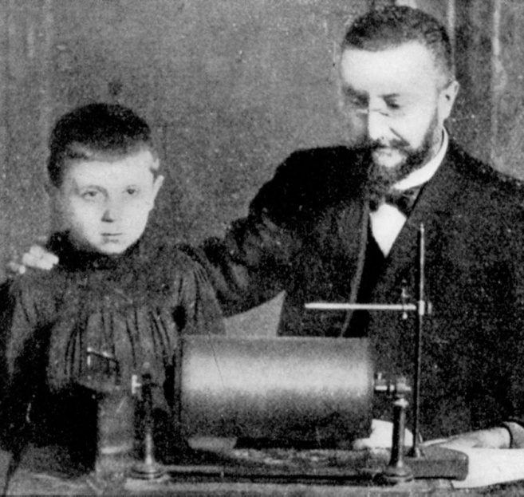
Intelligence and Intelligence Testing
Alfred Binet and Simon were hired by the French government to identify children who would not benefit from a traditional school setting and those who would benefit from special education. It was only meant to be used for class placement.

Slide 15
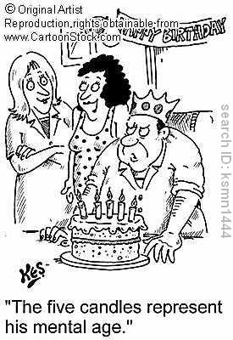
Intelligence and Intelligence Testing
The government had passed laws requiring that all French children attend school, so it was important to find a way to identify children who would need specialized assistance.
As a result children were assigned a Mental age (what a person of a particular age should know).
Hoped they could use test to help children, not label them.
http://education-portal.com/academy/lesson/methods-of-measuring-intelligence-interpreting-an-iq-scores-score-range.html#lesson

Slide 16
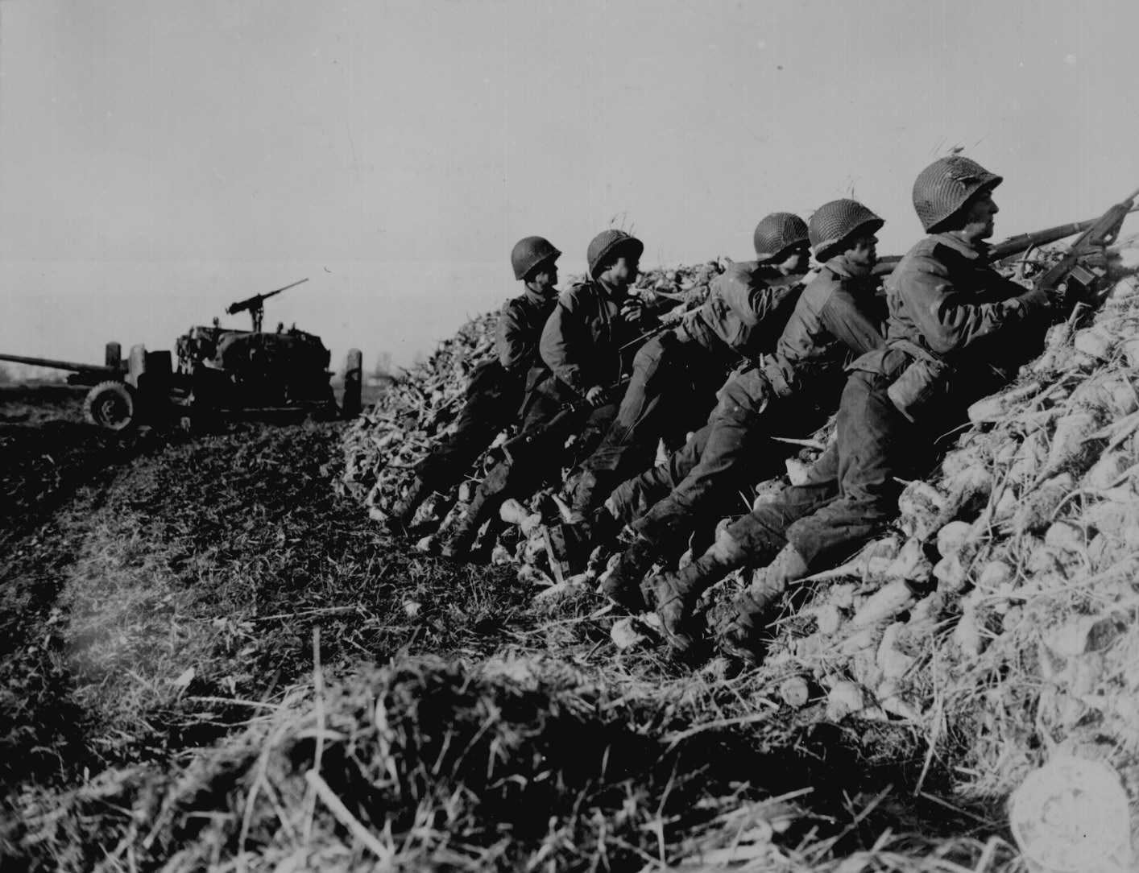
At the outset of World War I, U.S. Army officials were faced with the monumental task of screening an enormous number of army recruits. In 1917, as president of the APA and chair of the Committee on the Psychological Examination of Recruits, psychologist Robert Yerkesdeveloped two tests known as the Army Alpha and Beta tests. The Army Alpha was designed as a written test, while the Army Beta was administered orally in cases where recruits were unable to read.

Slide 17
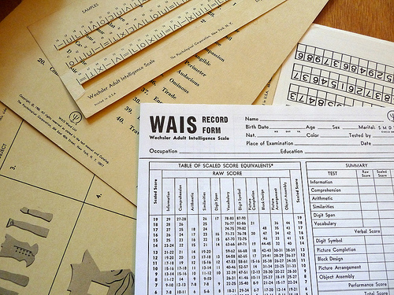
Wechsler Tests
David Wechsler developed another set of age-based intelligence tests. More common way to give IQ tests….does not use the formula but uses the same scoring system. Rather than score the test based on chronological age and mental age, as was the case with the original Stanford-Binet, the WAIS is scored by comparing the test taker's score to the scores of others in the same age group.
More helpful for determining the extremes of intelligence.

Slide 18
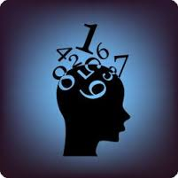
Terman and his IQ Test 'Stanford-Binet Intelligence Scale'
Stanford University psychologist Lewis Terman took Binet's original test and standardized it using a sample of American participants. This adapted test, first published in 1916, was called the Stanford-Binet Intelligence Scale and soon became the standard intelligence test used in the U.S.
The Stanford-Binet intelligence test used a single number, known as the intelligence quotient (or IQ), to represent an individual's score on the test. This score was calculated by dividing the test taker's mental age by their chronological age, and then multiplying this number by 100.

Slide 19
The Flynn Effect

