Slide 1
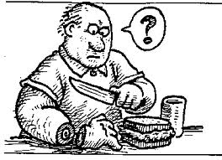
Testing and Individual Differences pt. 2 Intelligence
cantrip.org
cantrip.org
cantrip.org
What makes us smart?
Or not so smart?

Slide 2
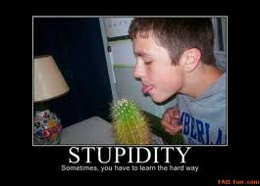
Intelligence and Intelligence Testing
Intelligence: aggregate or global capacity of the individual to act purposefully, to think rationally, and to deal effectively with his environment.
failfun.com

Slide 3
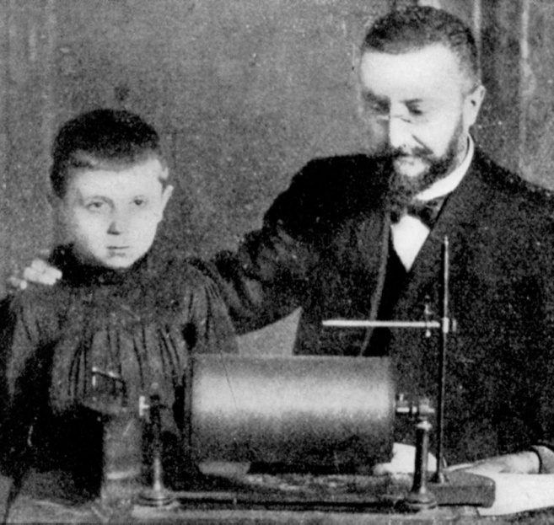
Intelligence and Intelligence Testing
Alfred Binet and Simon were hired by the French government to identify children who would not benefit from a traditional school setting and those who would benefit from special education. It was only meant to be used for class placement.

Slide 4
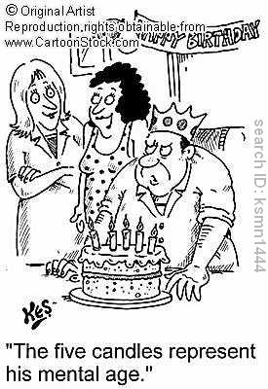
Intelligence and Intelligence Testing
Binet thought that as we age, we become more sophisticated in the ways we know about the world and so 6 year old would answer questions differently than 8 year olds.
As a result children were assigned a Mental age (what a person of a particular age should know).
Hoped they could use test to help children, not label them.

Slide 5
Terman and his IQ Test 'Stanford-Binet Intelligence Scale'
Used Binet’s research to construct the modern day IQ test called the Stanford-Binet Test.
IQ=Mental age/Chronological age X 100.
A 8 year old has a mental age of 10, what is her IQ?
A 12 year old has the mental age of 9, what is his IQ?
A boy has the mental age of 10 and an IQ of 200, how old is he?

Slide 6
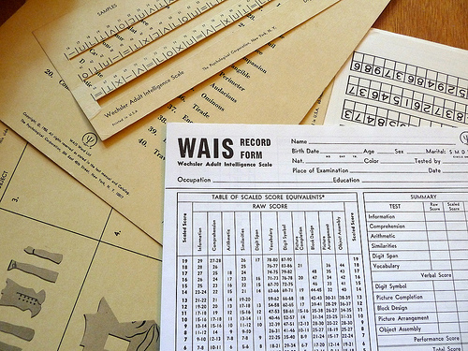
Wechsler Tests
David Wechsler developed another set of age-based intelligence tests. More common way to give IQ tests….does not use the formula but uses the same scoring system.
More helpful for determining the extremes of intelligence.

Slide 7
Mental Retardation vs. Genius
Mental Retardation: When test takes fall below the mean score of 70 on IQ test. Weshsler test. WAIS

Slide 8
Normal Distribution

Slide 9
Genius: when above 130

Slide 10
Charles Spearman and his G factor
Used factor analysis and discovered that what we see as many different skills is actually one General Intelligence.
If you are good at one subject you are usually good at many others.
Jack Bauer is good at torturing, bomb defusing, shooting, figuring out evil plots and saving the country (and he is good looking). Is there anything he cannot do?

Slide 11
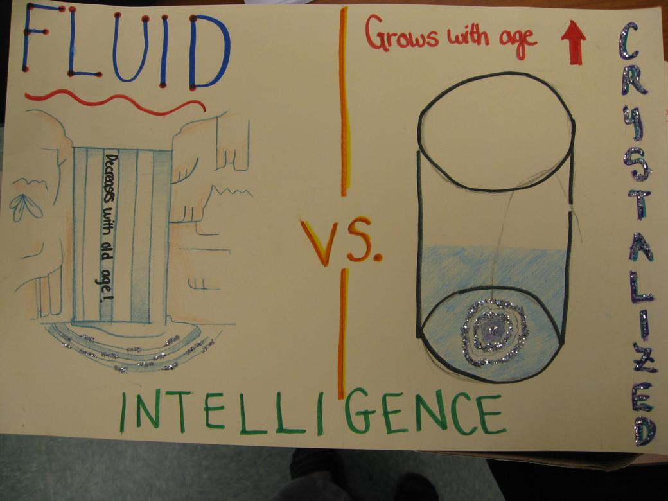
Charles Spearman and his G factor
John Horn and Taymond Cattell determined that Spearman’s g should be divided into two factors of intelligences:
Fluid Intelligence: cognitive abilities requiring speed or rapid learning that tend to diminish with adult aging
Crystallized intelligence: learned knowledge and skills such as vocabulary that tend it increase with age.

Slide 12
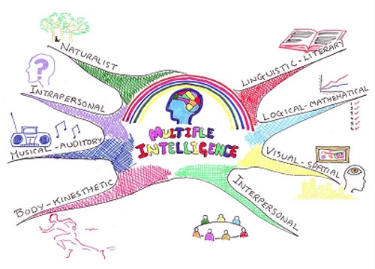
Howard Gardner and Multiple Intelligences
Gardner believed that there exists at least 8 different types of intelligences
Linguistic
Logical-mathematical
Spatial
Musical
Body-kinesthetic
Intrapersonal
Interpersonal
Naturalist

Slide 13
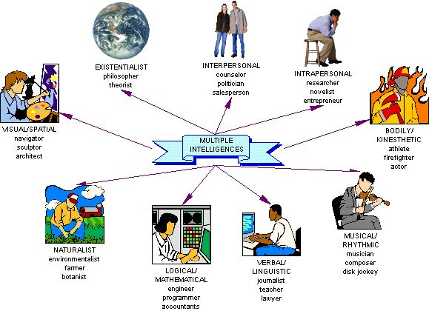
Gardner’s Theory of Multiple Intelligence

Slide 14
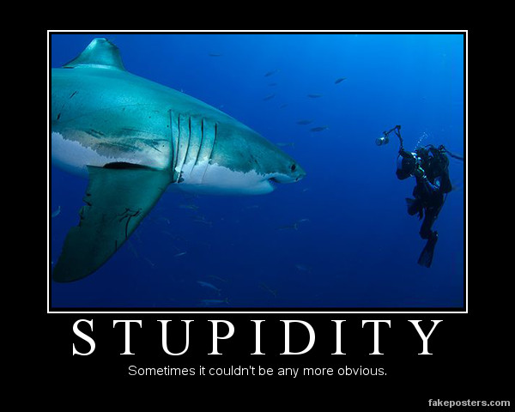

Slide 15
Robert Sternberg and his Triarchic Theory
Most commonly accepted theory today.
Three types of intelligence
Analytical what is tested by IQ test, what we are asked to do in school
Creative: adaptive reaction to novel situations, showing insight, and being able to see more than one way to solve a problem.
Practical: “street smarts” ability to read people, knowing how to put together a bake sale

Slide 16
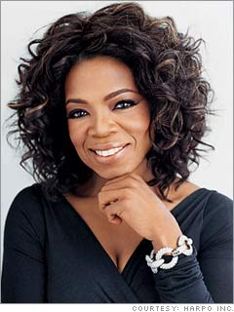
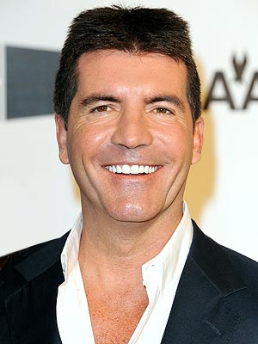
Goleman and his EQ Emotional Intelligence
Emotional Intelligence
Interpersonal and intrapersonal intelligences.
Maybe EQ is a better predictor for future success than IQ.

Slide 17
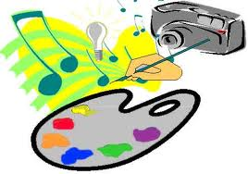
Creativity
Creativity: ability to generate ideas and solutions that are original, novel, and useful. Not usually measured by intelligence tests.
Threshold Theory: a certain level of intelligence is necessary but not sufficient for creative work.

Slide 18
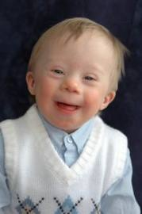
Heredity/Environment and Intelligence
Nature/Nurture controversy: what extent is intelligence hereditary and what is learned.
Nature:
Down’s Syndrome
Nurture:
Fetal Alcohol Syndrome (environmental)

Slide 19
Heredity/Environment and Intelligence
Studies of Twins:
Identical twins have similar scores on intelligence tests. Intelligence scores of adoptees are more like those of their biological parents than their adopted parents. Brain scans of twins reveal similar brain volume and anatomy.

Slide 20
Heredity/Environment and Intelligence
Environmental Influences on Intelligence::
Siblings raised together are more similar in IQ than siblings raised apart.
Children from deprived homes then moved into middle/upper class foster homes tend to increase iq. School attendance results in increased IQ scores. In fact, scores tend to steadily increase. James Flynn observed that we start doing better on tests called the FLYNN EFFECT

Slide 21
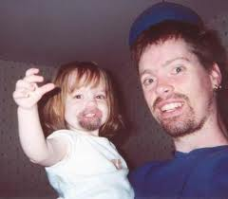
Heredity/Environment and Intelligence
Heritability:
Results from genetic causes. Hereditability for intelligence estimates range 50 to 75%
Reaction Range Model: genetic makeup determines the upper limit for an individual’s IQ.

Slide 22
Brain Size and Intelligence Is there a link?
Small +.15 correlation between head size and intelligence scores (relative to body size).
Using an MRI we found +.44 correlation with brain size and IQ score.

